Slide 1
Python Excercise
1019- 4110E240

Slide 2
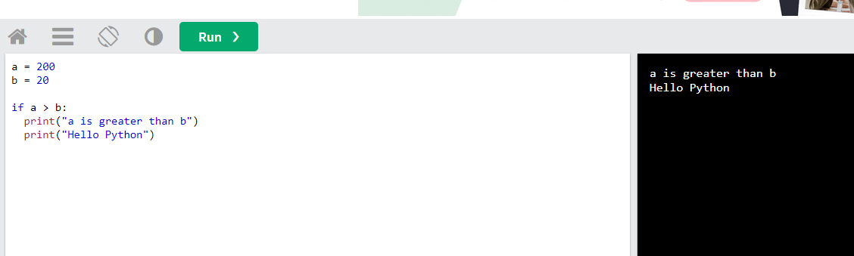
Exercise: 1

Slide 3
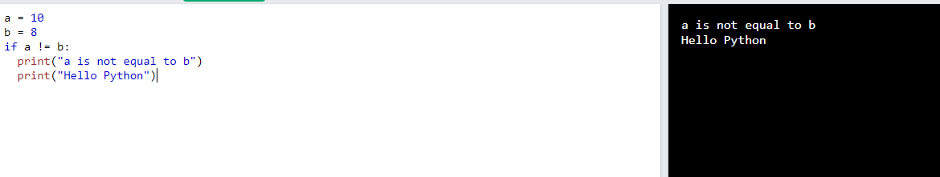
Exercise: 2

Slide 4
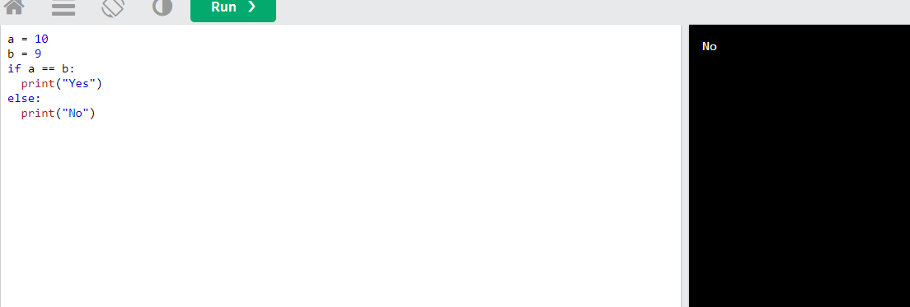
Exercise: 3

Slide 5
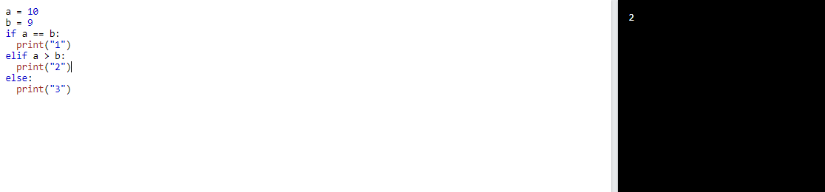
Exercise: 4

Slide 6
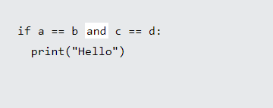
Exercise: 5

Slide 7
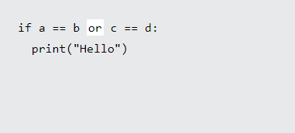
Excercise : 6

Slide 8
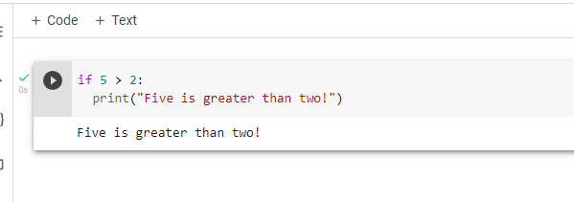
Exercise 7

Slide 9
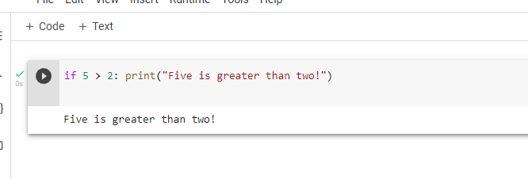
Excercise 8

Slide 10
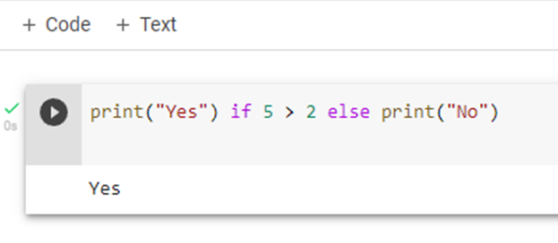
Excercise 9

